Slide 1
Introduction to Winforms

Slide 2
Objectives
Difference between Console and Windows Application
The challenges for Windows Applications
Notes:
When we design the software application the primary consideration should be the people who will use the application.By keeping in mind the target audience we have to design the user interface.user interface provides the mechanism for users to interact with application.Here we are discussing about the different type of application which has different user interface.We are focussing more into windows applications and the challenges we have

Slide 3
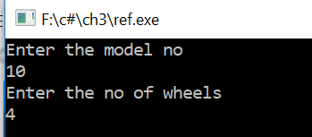
Difference between Console and Windows Application
Software Applications can be interacted in two ways
By Character User Interface-CUI
By Graphical User Interface-GUI
CUI is a way for users to interact with computer programs by giving commands.
The below figure shows how CUI Application looks like
Notes:
When we design a character user interface or CUI the commands to run the application should be known to the user,the user will be able to interact command by command.when we develop a console kind of application the user interface we are developing is CUI.DOS,Linux all are having CUI interface.

Slide 4
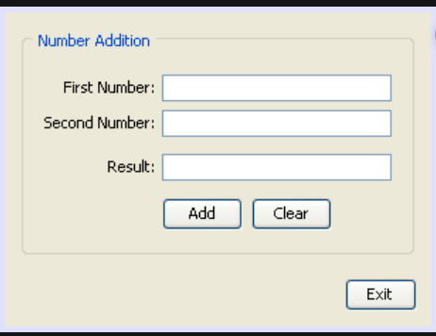
Difference between Console and Windows Application
GUI is a program interface that takes advantage of the computer's graphics capabilities to interact with the system
The below figure shows a GUI Interface
Notes:
When we work on GUI application the interaction to application becomes easy.No need to remember any commands. Graphical user interface is available which can be interacted with the help of mouse or key board. Forms are the primary element of a microsoft windows application.controls and menus can be added to forms to give specific functionalities.The figure in the slide shows a windows form which gives the user interface to enter data and do interaction. Forms contain a set of related information and options that provide the users how to proceed in an application.controls make information and options accessible to users.Menus and toolbars provide structured way to expose available commands of application

Slide 5
GUI Application
Easy to learn and use
No need to remember syntax while interacting
All functionalities can be executed by mouse
Notes:
The slide shows the advantages a GUI interface gives to the user. Users will be easily able to use GUI application. we can interact with application by seeing the graphics. Each functionality in a gui can be executed by mouse. we take the example of a notepad or desktop calculator. All these applications are GUI.

Slide 6
Challenges for Windows Application
The inability to make very rich UIs
Difficult to implement animation and special effects
Lack of scalability
Lack of data Binding Capability
Not easy to customise
Difficult to implement modern functionality
Notes:
The points in the slide shows what all challenges are there for windows application. limited controls and features make it difficult to have more flexible controls. Animation to add is difficult as no supporting build in library are available. Scalability of the application interface is not possible. The modern accessible functionalities are difficult to implement

Slide 7
Basic Concepts of GUI Programming

Slide 8
Objective
Components and Controls for Windows Forms
Layout of Controls
Event Handling in Winforms
Some Common Control Properties
Notes:
This module we discuss about the different types of controls and components to design a GUI in windows application. The common layout patterns for the controls. how controls are behaving and how to implement when an event(action) happens in a windows form. What are the properties available for controls to change the look and feel of the controls

Slide 9
Components and Controls for Windows Forms
A controls in a graphical user interface is an element used for interaction, such as a button or a TextBox.
Controls are software components that a computer user interacts to read or edit information about an application
Containers are used to group controls added to them, for example windows, panels , and tabs.
Notes:
The form is the primary element of windows froms. Every form is class. To create a form you can create instances of Form class. Controls are the second main element of a windows forms application after Form.Controls are used to create or enhance the functionalties of an application.Buttons and textBoxes are designed to receive user inputs and carry out basic task associated with user interaction.Components are designed to manage complex interactions with other parts of application.Windows ,panels and tabs are the compnents.Controls have visual interface.Components doesn’t have a visual interface.

Slide 10
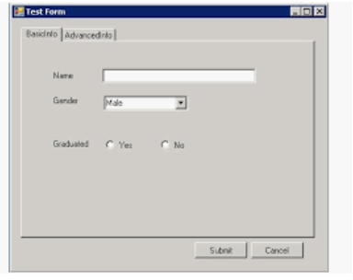
Components and Controls for Windows Forms
Notes:
The figure shows a Windows forms application GUI which is having controls and components.There are variety of preset controls which we can use to develop application.Controls are hosted in the form and implement most of the functionality of interface.The figure shows controls like buttons,label,textBox and Radio button

Slide 11
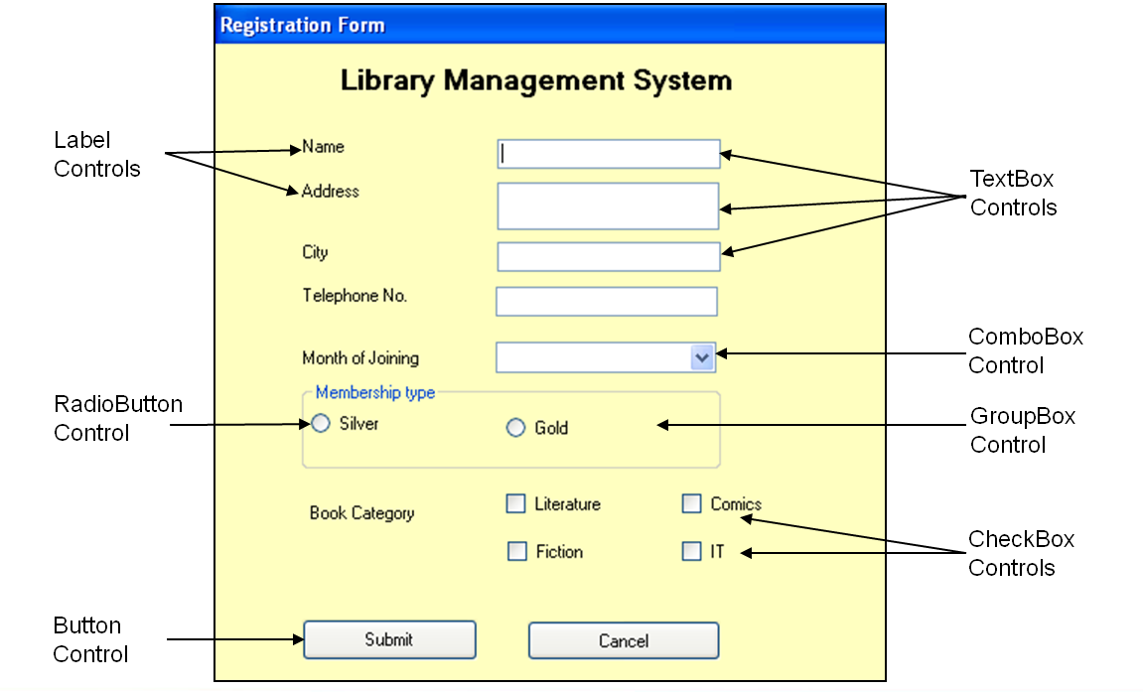
Controls
Notes:
We can create a windows forms application using Visual studio IDE.Select the windows application template create a new application.By default a windows form will be added.The controls which required to have in the user interface can be added from toolbox available in the IDE.The common controls:
Button Controls: The Button, CheckBox, and RadioButton controls are designed to permit users to make one or more selections on a form.
PictureBox and TextBoxt Controls: The PictureBox control is used to display and scale images; the TextBox control can be used to easily display and edit single or multiple lines of text.
List Controls: The ListBox, ComboBox, and CheckListBox offer different interfaces for displaying and manipulating data in a list format.
ListView and TreeView Controls: The ListView offers multiple views for displaying data items and their associated icons. The TreeView presents hierarchical information in an easy-to-navigate tree structure.
Timer and Progress Bar Controls: A timer can be used to control when an event is invoked, a ProgressBar to visually monitor the progress of an operation.

Slide 12
GUI Control Components
Button - has a textual label and is designed to invoke an action when pushed.
Checkbox - has textual label that can be toggled on and off.
ComboBox - is a component that provides a pop-up menu of choices.
Label - is a component that displays a single line of read-only, non-selectable text.
List - is a component that defines a scrollable list of text items.
Scrollbar - is a slider to denote a position or a value.
TextField - is a component that implements a single line of text.
TextArea - is a component that implements multiple lines of text.
Notes:
We can add form to a windows application and can control the appearance of form with the help of different methods.Common forms methods are:Form.Show(),Form.ShowDialog(),Form.Active(),Form.Hide(),Form.Close()
The above controls mentioned in the slide can be added to a windows form one by one.Moving the control from designer to form sets the position properties of the control.After adding the above controls you can right click on the control and set different properties.

Slide 13
Layout of Controls
Control layout implements a layout policy that defines spatial relationships between components in a container
FlowLayOut- Represents a panel that dynamically lays out its contents horizontally or vertically
Table LayOut- Represents a panel that dynamically lays out its contents in a grid composed of rows and columns.
Notes:
The Layout defines the way in which the controls are arranged in a windows form.There are two types of layout model is available in windows forms. We can switch to Table or Flow Layout modes that provide specific patterns, according to which UI elements are arranged.
Table Layout
Implements a grid-like mark-up for the content area. Form elements use row and column indexes to occupy specific grid cells. Row span and column span values allow you to stretch elements across multiple cells.
Flow Layout
In this mode, layout group regions are divided into multiple blocks of the specific size. Layout elements are arranged one after another and are wrapped at the group's right edge if there are insufficient free blocks to host the wrapped element.
Once we create a form we can add TableLayoutPanel or FlowLayout panel.Then we can place the control so that it will be placed according to the layout pattern.

Slide 14
Event Handling in Winforms
Every form is a class derived from the form class of the System.Windows,Forms namespace
An Event is generated when user performs an action as pressing the key or clicking the mouse
While the user needs to call the method explicitly ,the code within the event handler method gets executed
Notes:
Events represent the incident that happens during program execution.each control can raise a variety of events corresponds to different user interactions.as an example clicking a button.when a button clicked the application raises button click event and look for a method to handle the event.if methods are found it will exexute that method and crresponding output is coming as response .we can link the events to method by going to the proprty window of the corresponding controls events.

Slide 15
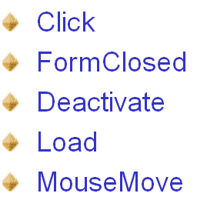
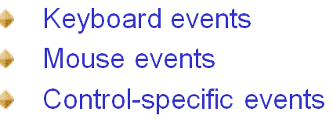
Event Handling in Winforms
Common Events used in a form are
The events associated with various controls are
Notes:
The event can be raised in the basic form of the windows application.the events given in the slides are the common events happening in the form.There are many types of events associated to different controls.Events raised if any key board actions happens like keyDown,keyup actions are coming under keyboard events.mouse click,mouse hover all are coming mouse events.Certain controls control specific events like command events,selection changed events are available.We can link any event with the corresponding event handlers and handle them.

Slide 16
Some Common Control Properties
Each control has its own set of properties events and methods which make it suitable for a particular task
Can set the properties of the controls during design time by using control properties
Can set the properties of the control at runtime by writing the code
Notes:
When we design the form once we add the control the properties or atributes are appearing in the property A Windows Forms control inherits many properties form the base class System.Windows.Forms.Control. These include properties such as Font, ForeColor, BackColor, Enabled, Focused, Height, Width, Visible, AutoSize, and many others.

Slide 17
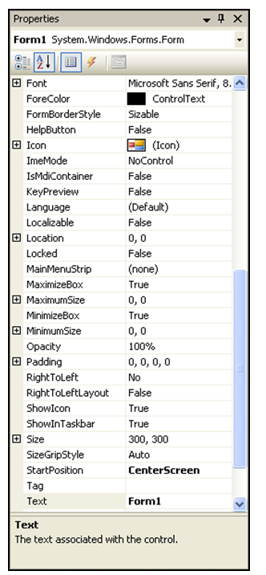
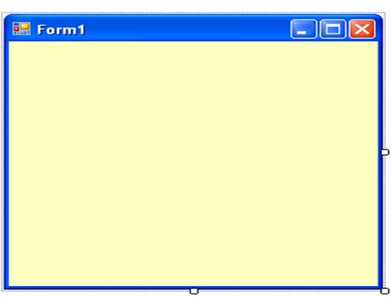
Some Common Control Properties
Properties of controls are used to set the appearance at runtime
Font – sets style,size and color of text
Size -sets the height and width of the control
Backcolor-sets backcolor of control
Notes:
After adding a control to a form, you can see its characteristics in the Properties window:
The box on the right side of each property name represents the value of the property that you can set for an object. There are various kinds of fields you will use to set the properties
For every control has font propery which set the style,size and color of the text appearing on the control
Size sets the height and width of the control.
The different color properties like background,fore color all we can set using color property

Slide 18
Developing Desktop Applications

Slide 19
Set the Tab Order for Controls
The tab order is the order in which a user moves focus from one control to another by pressing the Tab key.
By default, the tab order is the same as the order in which controls are created .
Tab-order numbering begins with zero
tab order can be set in the Properties window using the TabIndex property
Notes:
The users of the application can use the tab key to quickly move the focus from one control to another.The tab order sets the order in which controls on the form receives focus.The tab order is specified by the tab index property. To change the order in which tab gets focus simply change the tab index value to a different number.lower values get first focus .tab index value starts from zero.

Slide 20
Set Tab Order on a Form
Open a Form in the Form Editor.
From the Form menu bar, select Form>View/Set Tab Order. ...
Click each Field or Button Control in the order you want to tab.
When you are done, select Form>View/Set Tab Order again to save the tab ordering.
Notes:
As described in the slide

Slide 21
Anchor a Control in Windows Forms
Forces the control to anchor itself in a relative or absolute position within the parent form or control.
This property has four values that can be turned on or off:
Top — Indicates that the control should keep its top edge stationary in respect to the parent form (or control)
Bottom — Indicates that the control should keep its bottom edge stationary in respect to the parent form (or control)
Left — Indicates that the control should keep its left edge stationary in respect to the parent form (or control)
Right — Indicates that the control should keep its right edge stationary in respect to the parent form (or control)
Notes:
The anchor property of a control dictate how it behaves inside the form or parent control.Anchor property allows us to define a constant distance between a control and one or more edge of the form.So when the user resizes the form the controls will keep the contant distance from the edges.The four values of anchor property and how it will behave is described in the slide.

Slide 22
Anchor a Control in Windows Forms
To set the Anchor property on a control, simply select the control in the Visual Studio designer
Go to the properties window.
Click property labeled "Anchor".
Clicking in the value section for this property will bring up a little window that allows you to choose which anchor points you wish to assign to the control.
Notes:
Do the demo as described in the slide

Slide 23
Dock a Control in Windows Forms
Gets or sets which control borders are docked to its parent control and determines how a control is resized with its parent.
Bottom - The control's bottom edge is docked to the bottom of its containing control. Fill - All the control's edges are docked to the all edges of its containing control and sized appropriately. Left - The control's left edge is docked to the left edge of its containing control. None - The control is not docked.
Notes:
The dock property allows to attach a control to the edge of the form or completely fill the form. The docked control will resize itself when the user resizes the form. The example of a docked control is a menu bar at the top of the form. we can select the dock property in the property window of the control and set to any value mentioned in the slides

Slide 24
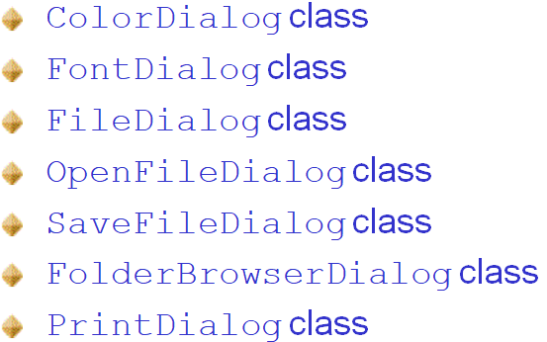
Dialog Boxes
CommonDialog class is the base class for displaying common dialog boxes
The various classes inherited from CommonDialog class are
Notes:
The Common Dialog Box of windows library Library contains a set of dialog boxes for performingcommon application tasks, such as opening files, choosing color values, and printing documents. The common dialog boxes allow you to implement a consistent approach to your application's user interface.
Color Dialog Box Displays available colors and optionally lets the user create custom colors. The user can select a basic or custom color. Use the choose color function
Font Dialog Box Displays a dialog box in which the user can select a font family and associated font style, point sizes, and other font attributes such as font color, underline, or strikethrough. Use the choosefont function .
Open and Save As Dialog Boxes
Displays a dialog box in which the user can type or select the name of a file to open. The dialog box includes lists of drives, directories that enable the user to browse. It also includes a list of file name extensions that enables the user to filter the file names displayed. Use the GetOpenFileName function
Displays a dialog box in which the user can type or select the name with which to save a file. The dialog box includes lists of drives, directories, and shell name-space extensions that enable the user to browse. It also includes a list of file name extensions that enables the user to filter the file names displayed. Use the GetSaveFileName function
FolderBwoser Dialog boxes
Displays a dialog box in which the user can type or select the name of the folder to browse.
PrintDialog Box
Displays information about the installed printer and its configuration. The user can select print job options, such as the range of pages to print and the number of copies, and start the printing process.

Slide 25
Working with MDI Forms

Slide 26
SDI vs. MDI Applications
MDI and SDI are interface designs for handling documents within a single application.
MDI stands for “Multiple Document Interface”
SDI stands for “Single Document Interface”.
One document per window is enforced in SDI
Child windows per document are allowed in MDI.
MDI is a container control while SDI is not container control.
MDI supports many interfaces means we can handle many applications at a time
SDI supports one interface so only one application at a time
Notes:
MDI (Multiple Document Interface) is a Microsoft Windows programming interface for creating an application that enables users to work with multiple documents at the same time. Each document is in a separate space with its own controls for scrolling. The user can see and work with different documents such as a spreadsheet, a text document, or a drawing space by simply moving the cursor from one space to another. MDI applications can be used for a variety of purposes - for example, working on one document while referring to another document, viewing different presentations of the same information
SDI applications allow only one open document frame window at a time.

Slide 27
Creating MDI Applications
MDI application consist of two parts MDI parent and MDI child
MDI parent form can be created at the design time or run time by setting IsMdiContainer property of the form to true
To arrange the opened child forms in the MDIParent form write the following code
this.LayoutMdi(MdiLayout.TileVertical)
Notes:
Here the child forms can be arranged within the parent MDI form in several different ways. The LayoutMdi method is used to arrange the child forms. This method takes different parameters to arrange the child forms.
protected void MDIChildNew_Click(object sender, System.EventArgs e)
{
Form2 newMDIChild = new Form2();
// Set the Parent Form of the Child
window. newMDIChild.MdiParent = this;
// Display the new form. newMDIChild.Show();
}

Slide 28
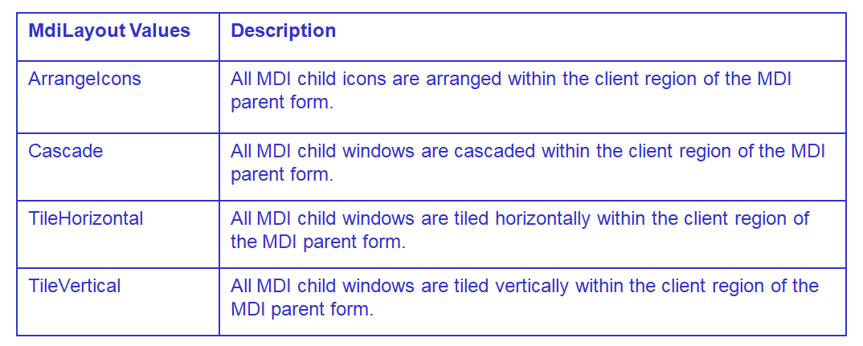
Creating MDI Child Forms
There are 4 MdiLayout values
Notes:
The values of the MdiLayout method for arranging child forms in several ways.
Create a new Windows Forms application project in Visual Studio. In the Properties window for the form, set its IsMdiContainer property to true and its WindowsState property to Maximized.
This designates the form as an MDI container for child windows.
From the Toolbox, drag a MenuStrip control to the form. Set its Text property to File.
Click the ellipsis (…) next to the Items property, and click Add to add two child tool strip menu items. Set the Text property for these items to New and Window.
In Solution Explorer, right-click the project, and then select Add > New Item.
In the Add New Item dialog box, select Windows Form (in Visual Basic or in Visual C#) from the Templates pane. In the Name box, name the form Form2. Select Open to add the form to the project.

Slide 29
Working with Menus

Slide 30
Advantages of Menu
Windows environment uses menus to enhance user interface of an application
Two types of menu can be created
Menu appears in the menu bar
Context menus which appear when the right mouse button is clicked
Notes:
The importance and advantages of using menus in GUI applications. The two ways in which we can access the menu. menus provide us the following uses.
Menus enable the users to quickly perform an action
The users need not to remember the commands

Slide 31
How to Create a ToolStrip
Tool strip control Provides a container for Windows toolbar objects
The ToolStrip controls provide a common interface for Menus and Strips in Windows Forms.
Can provide button to toolbar at design or run time
add a toolstrip control to windows form
From properties window of toolstrip control access item property
At run time first add toolstrip control.Then write code to add item to toolstrip control
Notes:
ToolStrip control provides functionality of Windows toolbar controls. A ToolStrip control is capable of hosting Button, Label, SplitButton, DropDownButton, Separator, ComboBox, TextBox and ProgressBar controls. Each individual element on the ToolStrip is a ToolStripItem that manages the layout and event model for the type it contains. The ToolStrip controls provide a common interface for Menus and Strips in Windows Forms. We can see with a demo.

Slide 32
How to Create a Menu
Menu can be added at the design time or at run time
To add menu item at design time:add menustrip control from the tool box
Append individual menuItem using menu designer
To add menu item at run time
Add the menustrip control from the tool box at design time
Write code to programatically add toolstripMenuItem objects to Menustrip objects
Notes:
Menu allows users to access top level commands and functions in a familiar easy to understand interface. When we design the menu look in to the logical flow of the application. Menu items should be grouped according to the relational functionality. Menustrip control should be added to the form first and then each menustrip items can be added. We can create event handlers for menuItem to handle events. Click event, select event and popup events are the common events. The following code creates a menu.
public MenuTest1()
{
InitializeComponent();
mainMenu = new MainMenu();
MenuItem File = mainMenu.MenuItems.Add("&File");
File.MenuItems.Add(new MenuItem("&New"));
File.MenuItems.Add(new MenuItem("&Open"));
File.MenuItems.Add(new MenuItem("&Exit"));
this.Menu = mainMenu;
MenuItem About = mainMenu.MenuItems.Add("&About");
About.MenuItems.Add(new MenuItem("&About"));
this.Menu = mainMenu;
mainMenu.GetForm().BackColor = Color.Indigo;
}

Slide 33
How to Create a Context Menu
ContextMenu can be added at the design time or at run time
To add Contextmenu item at design time:add menustrip control from the tool box
Append individual menu for a control or a form add the ContextMenuStrip fom the toolBox to the form
Notes:
Context menus are menus that appear when controls right clicked. Context menu are created with contextMenu component. We can add menuItem to the context menu. To associate a contextMenu to a particular form or control set the contextmenu property to the appropriate menu. The following code snippet sets the background color, foreground color, text name and font properties of a context menu.
PopupMenu.BackColor = Color.OrangeRed;
PopupMenu.ForeColor = Color.Black;
PopupMenu.Text = "File Menu";
PopupMenu.Font = new Font("Georgia", 16);

Slide 34
How to Create a Status Bar
A StatusBar control typically displays information about an object being viewed on a Form,
It displays object's operation within your application
A typical StatusBar sits at the bottom of a form.
Add status bar from toolBox
make sure ShowPanels property of status bar is true.
Notes:
This control should be used to specify messages that can help the user identify the correct data to be entered by the user. The StatusStrip control is a container control derived from System.Windows.Forms.ToolStrip class.
This control is used to:
Display information about the objects that are on the current form.
Provide feedback on the progress of any operation being performed by the form.
A StatusStrip control contains four child controls. These child controls are:
StatusLabel
ProgressBar
DropDownButton
SplitButton

Slide 35
Status Bar
Status Bar control is not available in VS 2010 onwards.
Statusstrip control replaces the status bar.
A StatusBar control is a combination of StatusBar panels where each panel can be used to display different information
Notes:
StatusBar mainStatusBar = new StatusBar();
StatusBarPanel statusPanel = new StatusBarPanel();
The following code snippet adds the two panels created to the status bar :
StatusBarPanel datetimePanel = new StatusBarPanel();
// Set first panel properties and add to StatusBar
statusPanel.BorderStyle = StatusBarPanelBorderStyle.Sunken;
statusPanel.Text = "Application started. No action yet.";
statusPanel.ToolTipText = "Last Activity";
statusPanel.AutoSize = StatusBarPanelAutoSize.Spring;
mainStatusBar.Panels.Add(statusPanel);
// Set second panel properties and add to StatusBar
datetimePanel.BorderStyle = StatusBarPanelBorderStyle.Raised;
datetimePanel.ToolTipText = "DateTime: " + System.DateTime.Today.ToString();
datetimePanel.Text = System.DateTime.Today.ToLongDateString();
datetimePanel.AutoSize = StatusBarPanelAutoSize.Contents;
mainStatusBar.Panels.Add(datetimePanel);

Slide 36
THANK YOU

